Slide 1

TND FLECKVIEH COW LIMITED capacity building program

Slide 2
INTRODUCTION
TND FLECKVIEH COW LIMITED is using a cooperative model to economically empower our members.
We serves all interested persons who join our party and access financial freedom. As a result of consistent growth, employment opportunities have risen within the organization.

Slide 3
Our Vision
To be a political party of choice in providing of financial services that enhance the participation of Groups in co-operative membership and leadership.

Slide 4
Our Mission
To empower members and business communities through provision of business opportunities, working capital and motivation of resources through the development of a savings, investment and credit culture among members.

Slide 5
Our core value
We believe a business is only as good as her members base and so here at TND FLECKVIEH COW LIMITED we strive for accountability at every level. Our aim is to cultivate proactive and responsive policies to constantly improve our product to provide world class services.

Slide 6
THE CRISIS

Slide 7
THE CRISIS
Agriculture in Kenya dominates Kenya’s economy and the largest contributor to Kenya’s gross domestic product (GDP).
However agricultural productivity has been stagnating in recent years, amid continuous population growth.
This poses critical challenges to food security in the country as two to four million people receive food aid annually.

Slide 8
THE CRISIS
With Kenya’s population rising to up to 65 million in 2030, the current agricultural model will not sustain the food demand of the masses and this is a crisis in the making.

Slide 9
IMPLICATION OF FOOD SHORTAGE
Malnutrition
Stunted growth
Human-wildlife conflict
Insecurity

Slide 10
THE SOLUTION

Slide 11
THE ONE COW PER GROUP OF TEN
The purpose of the one cow per group of ten program is to provide employment, health benefits, boost food security and support services for the groups which are in a disadvantaged positions due to poverty.

Slide 12
THE ONE COW PER GROUP OF TEN
Our goal is to decrease rates of poverty and ignorance by providing case management, support services, basic skills education, housing and resource coordination that can offer alternatives to habits and choices that may lead to criminal behaviors.

Slide 13
THE ONE COW PER GROUP OF TEN
The one cow per family group of ten is meant to improve the livelihoods, boost food security and address poverty eradication in Kenya.
The model is simple, the impact is great.

Slide 14
THE BENEFITS OF THE PROGRAM

Slide 15
BENEFITS OF THE PROGRAM
It is estimated that over 3 million groups will benefit from this program by the year 2030 and provide employment opportunity to over 45 million Kenyans across the country hence generating a revenue of Kes 600 billion per annum

Slide 16
THE COW BREED

Slide 17
FLECKVIEH
The Fleckvieh cow is durable, handy and easy to handle even within a small farm, they are able to move easily even in the most difficult terrain.
Fleckvieh is a handy breed that can resist diseases, eats less and produces more high quality milk.
Fleckvieh is a high yielding, dual-purpose cow that can be used for both dairy and beef production.

Slide 18
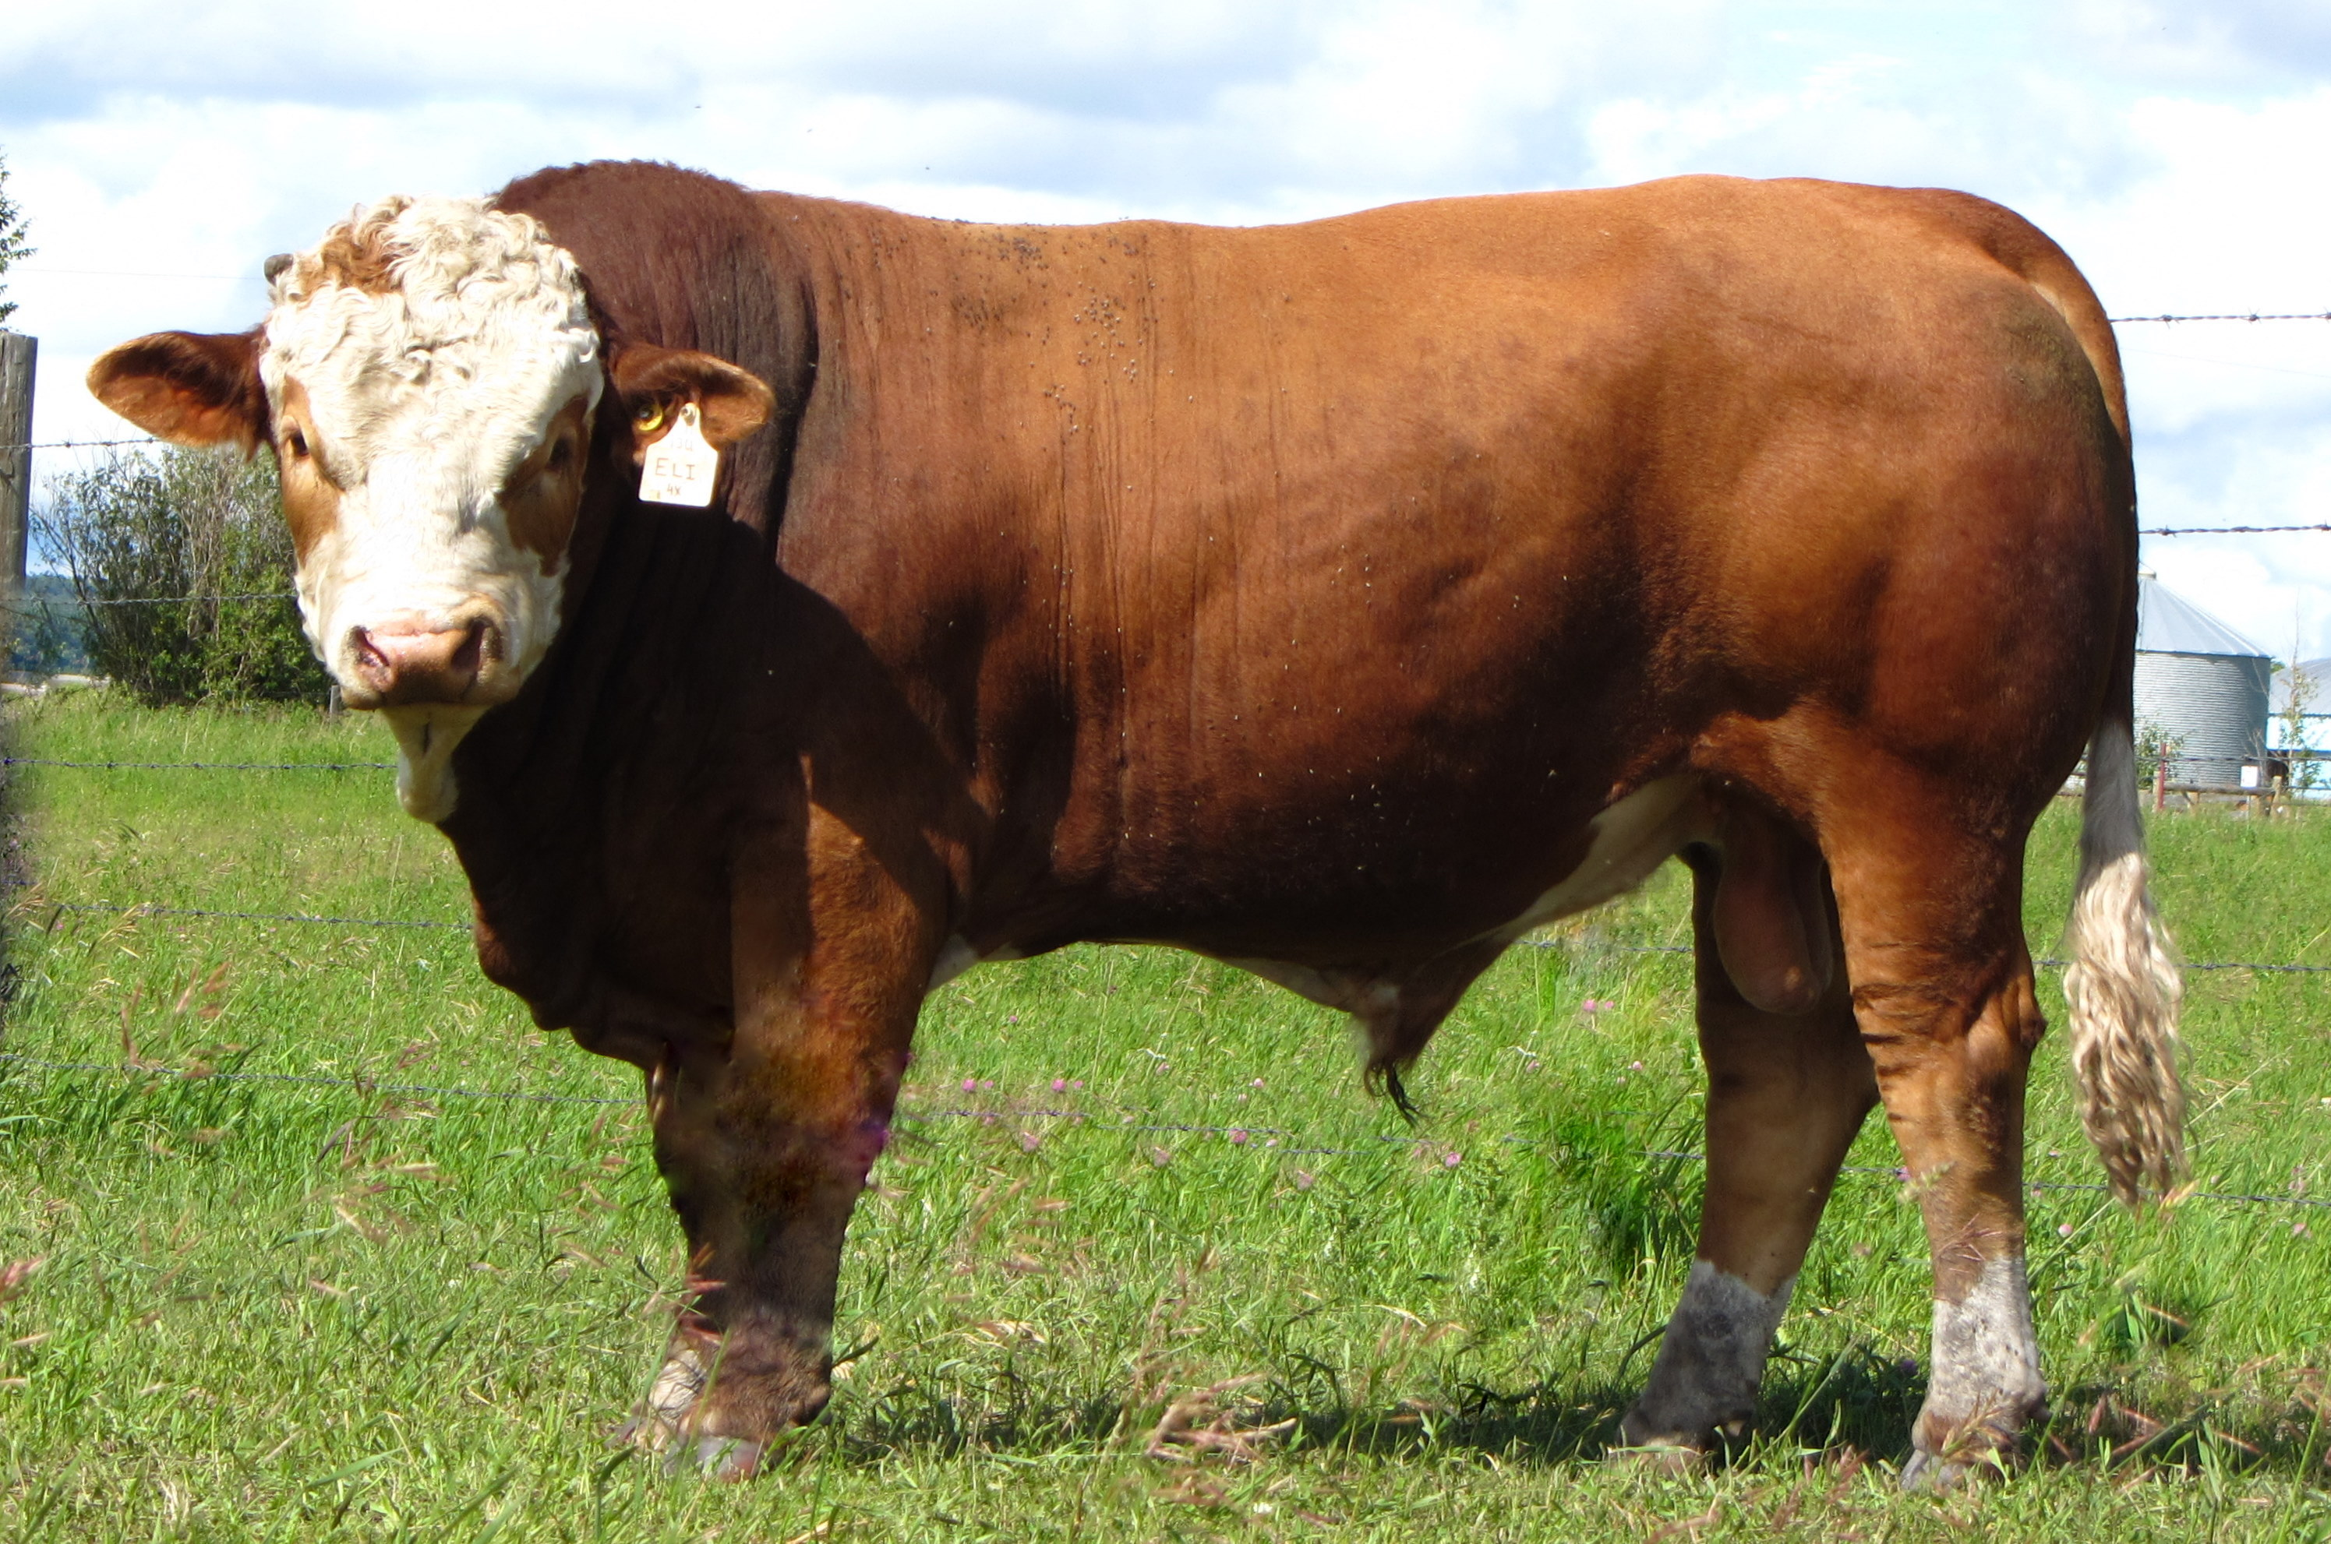
FLECKVIEH BULL
FLECKVIEH BULL

Slide 19
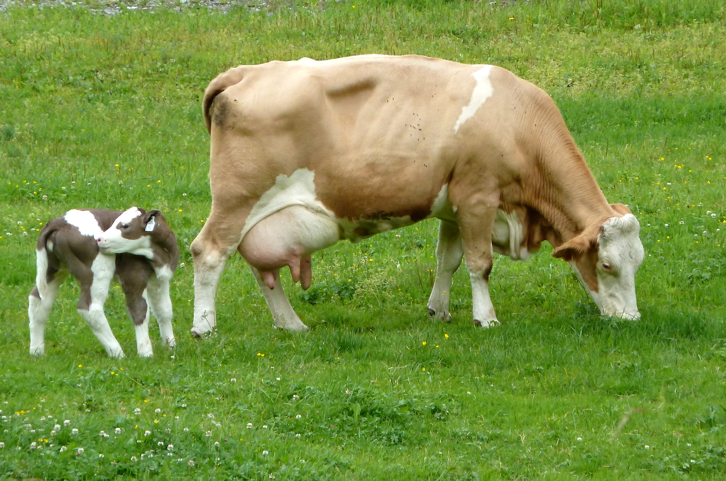
FLECKVIEH BULL
FLECKVIEH COW

Slide 20
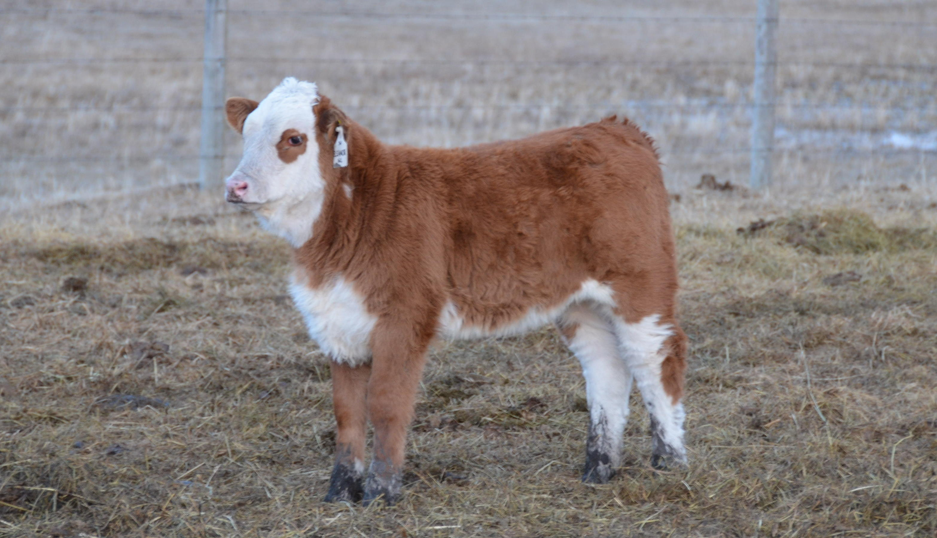
FLECKVIEH BULL
FLECKVIEH CALF

Slide 21
THE MERITS OF FLECKVIEH BREEDS OVER OTHER BREEDS

Slide 22
1. Milk and beef of high quality.
HIGH MILK QUALITY 45-60 litres per cow per day
QUALITY BEEF 300 - 500 kg per cow
Fleckvieh Milk is highly nutritious and can be used to prevent various diseases.
Reduces the risk of cancer Reduces blood pressure Reduces the risk of cardiac arrest

Slide 23
2. Higher calf prices.
In Europe and North America higher prices for calves are common place due to better health and growth rates. Steer calves can enter a feedlot and create another income stream for growers. Because the cows produce more calves(based on improved longevity), replacement heifers can be sold.
1 calf/ year with very Low Vet Costs

Slide 24
3. Excellent fertility.
Reductions in numbers of inseminations required to reach pregnancy are seen. This leads to a reduction in workload, easier breeding management, reduced inter calving periods and improved overall reproductive efficiency.

Slide 25
4. Strong “easy handling” cows.
Fleckvieh is well adapted to all kinds of climate.

Slide 26
TIME FRAME

Slide 27
TIME FRAME:
The implementation of the initial TND FLECKVIEH COW LIMITED capacity building programme is 36 months.

Slide 28
SCOPE OF OPERATION

Slide 29
SCOPE OF OPERATION
The TND FLECKVIEH COW LIMITED activities will be implemented across the 47 counties. Organized community groups capacity building service shall be expected to be present in ALL focus areas within the following regions:
Region 1:
Garissa
Wajir
Mandera
Isiolo
Region 2:
Turkana
West pokot
Samburu
Marsabit
Region 3:
Mombasa
Kwale
Kilifi
Tana River
Lamu
Taita Taveta
Region 4:
Meru
Tharaka-Nithi
Embu
Kitui
Makueni
Region 5:
Kakamega
Vihiga
Bungoma
Busia
Siaya
Region 6:
Kisumu
Homabay
Migori
Kisii
Nyamira

Slide 30
SCOPE OF OPERATION
Region 7:
Trans Nzoia
Uasin Gishu
Elgeyo/Marakwet
Nandi
Region 8:
Baringo
Nakuru
Narok
Kericho
Bomet
Region 9:
Nyandarua
Laikipia
Nyeri
Kirinyaga
Murang’a
Region 10:
Nairobi
Kajiado
Machakos
Kiambu

Slide 31
THE OUTCOME

Slide 32
Expected results community groups after capacity building
Should have capacity to translate the training programs into local languages in the areas they expect to work
Should have capacity and experience to develop and assist in carrying out of entrepreneurship campaigns.
Demonstrate experience in carrying out trainings for Youth and Women Programs on business planning and business modeling.
Experience in developing commercial entrepreneurship programmers or projects in Kenya and/or Africa;
Participation in community employment initiatives and research within their villages
Must demonstrate or have practical existing linkages with business, government and other stakeholders.
Acceptance of a direct performance contract where loans will be based on proven outputs more than time-based and activity loans
Improved capacity and willingness to meet the reporting, monitoring and evaluation requirements

Slide 33
THANK YOU

